Slide 1

Types of Attacks and Malicious Software
Chapter 15

Slide 2
Objectives
Describe the various types of computer and network attacks, including denial-of-service, spoofing, hijacking, and password guessing.
Identify the different types of malicious software that exist, including viruses, worms, Trojan horses, logic bombs, time bombs, and rootkits.
Explain how social engineering can be used as a means to gain access to computers and networks.
Describe the importance of auditing and what should be audited.

Slide 3
Key Terms
Auditing
Backdoor
Birthday attack
Botnet
Buffer overflow
Denial-of-service (DoS) attack
Distributed denial-of-service (DDoS) attack
DNS kiting
Drive-by download attack
Integer overflow
Logic bomb
Notes:
Auditing – Actions or processes used to verify the assigned privileges and rights of a user, or any capabilities used to create and maintain a record showing who accessed a particular system and what actions they performed.
Backdoor – A hidden method used to gain access to a computer system, network, or application. Often used by software developers to ensure unrestricted access to the systems they create. Synonymous with trapdoor.
Birthday attack – A form of attack in which the attack needs to match not a specific item but just one of a set of items.
Botnet – A term for a collection of software robots, or bots, that runs autonomously and automatically and commonly invisibly in the background. The term is most often associated with malicious software, but it can also refer to the network of computers using distributed computing software.
Buffer overflow – A specific type of software coding error that enables user input to overflow the allocated storage area and corrupt a running program.
Denial-of-service (DoS) attack – An attack in which actions are taken to deprive authorized individuals from accessing a system, its resources, the data it stores or processes, or the network to which it is connected.
Distributed denial-of-service (DDoS) attack – A special type of DoS attack in which the attacker elicits the generally unwilling support of other systems to launch a many-against-one attack.
DNS kiting – The use of a DNS record during the payment grace period without paying.
Drive-by download attack – An attack on an innocent victim machine where content is downloaded without the user’s knowledge.
Integer overflow – An error condition caused by the mismatch between a variable assigned storage size and the size of the value being manipulated.
Logic bomb – A form of malicious code or software that is triggered by a specific event or condition. See also time bomb.

Slide 4
Key Terms (continued)
Malware
Man-in-the-middle attack
Null session
Pharming
Phishing
Ransomware
Replay attack
Rootkit
Sequence number
Smurf attack
Sniffing
Spear phishing
Spoofing
Spyware
Notes:
Malware – A class of software that is designed to cause harm.
Man-in-the-middle attack – Any attack that attempts to use a network node as the intermediary between two other nodes. Each of the endpoint nodes thinks it is talking directly to the other, but each is actually talking to the intermediary.
Null session – The way in which Microsoft Windows represents an unauthenticated connection.
Pharming – The use of a fake web site to socially engineer someone out of credentials.
Phishing – The use of social engineering to trick a user into responding to something such as an e-mail to instantiate a malware-based attack.
Ransomware – Malware that encrypts sensitive files and offers their return for a ransom.
Replay attack – An attack where data is replayed through a system to reproduce a series of transactions.
Rootkit – A form of malware that modifies the OS in a system to change the behavior of the system.
Sequence number – A number within a TCP packet to maintain TCP connections and conversation integrity.
Smurf attack – A method of generating significant numbers of packets for a DoS attack.
Sniffing – The use of a software or hardware device (sniffer) to observe network traffic as it passes through a network on a shared broadcast media.
Spear phishing – A form of targeted phishing where specific information is included to convince the recipient that the communication is genuine.
Spoofing – Making data appear to have originated from another source so as to hide the true origin from the recipient.
Spyware – Malware designed to spy on a use, typically recording information such as keystrokes for passwords.

Slide 5
Key Terms (continued)
SYN flood
TCP/IP hijacking
Trojan
Typo squatting
Virus
Worm
Zombie
Notes:
SYN flood – A method of performing DoS by exhausting TCP connection resources through partially opening connections and letting them time-out.
TCP/IP hijacking – An attack where the attacker intercepts and hijacks an established TCP connection.
Trojan – A form of malicious code that appears to provide one service (and may indeed provide that service) but that also hides another purpose. This hidden purpose often has a malicious intent. This code may also be referred to as a Trojan horse.
Typo squatting – An attack form that involves capitalizing upon common typo errors.
Virus – A form of malicious code or software that attaches itself to other pieces of code in order to replicate. Viruses may contain a payload, which is a portion of the code that is designed to execute when a certain condition is met (such as on a certain date). This payload is often malicious in nature.
Worm – An independent piece of malicious code or software that self-replicates. Unlike a virus, it does not need to be attached to another piece of code. A worm replicates by breaking into another system and making a copy of itself on this new system. A worm can contain a destructive payload but does not have to.
Zombie – A machine that is at least partially under the control of a botnet.

Slide 6
Avenues of Attack
A computer system is attacked for one of two general reasons:
It is specifically targeted by an attacker.
Political reason
Chosen based on attacker’s motivation
Not reliant on target system’s hardware and software
It is a target of opportunity.
Systems with hardware or software vulnerable to a specific exploit
Difficult and take time and effort
Notes:
Generally, computer systems are attacked either as specific targets or merely as targets of opportunity.
An attacker’s motivation in specifically targeting a system may be political, monetary, or other.
In these instances the choice to attack does not rely on the exact hardware and software being used in the targeted system, but rather proceeds in spite of these details.
Target of opportunity attacks succeed when systems are found which have not been updated with the most current security patches and are therefore vulnerable to specific exploits.

Slide 7
Minimizing Possible Avenues of Attack
Steps to minimize possible attacks include:
Ensure all patches for the operating system and applications are installed.
Limit the services that are running on the system.
Limit public disclosure of private information about your organization and its computing resources.

Slide 8
Malicious Code
Malicious code, or malware, refers to software that has been designed for some nefarious purpose.
Patching of vulnerabilities is important, for it closes the point of entry for most malware.
Types of malicious software include:
Viruses, Trojan horses, logic bombs, spyware, and worms
Malware can be fairly complex in its construction.
Multipartite, polymorphic, and metamorphic
Notes:
Malware can be fairly complex in its construction, with specific features designed to assist malware in avoiding detection. Modern malware can be multipart in construction, where several pieces work together to achieve a desired effect.
When malware has multiple different objects that it specifically attacks, it is called multipartite.
Many types of malware can include a changing encryption layer to resist pattern-matching detection. These are called polymorphic.
If the malware actually changes the code at time of infection, this property is called metamorphic.

Slide 9
Viruses
The best-known type of malicious code is the virus.
A virus is a piece of malicious code that replicates by attaching itself to another piece of executable code.
When the other executable code is run, the virus also executes and has the opportunity to infect other files and perform any other nefarious actions it was designed to do.
The specific way that a virus infects other files, and the type of files it infects, depends on the type of virus.
The first viruses created were of two types:
Boot sector viruses and program viruses

Slide 10
Viruses (continued)
A boot sector virus infects the boot sector portion of a floppy disk or hard drive.
A program virus attaches itself to executable files so that it is executed before the program executes.
Most program viruses also hide a nefarious purpose, such as deleting the hard drive data.
A macro virus results from software that includes macro-programming languages.
Best practice is to advise users never to open a document attached to an e-mail if it seems at all suspicious.
Notes:
Boot Sector Virus – A boot sector virus infects the boot sector portion of either a floppy disk or a hard drive (years ago, not all computers had hard drives, and many booted from a floppy). When a computer is first turned on, a small portion of the operating system is initially loaded from hardware. This small operating system then attempts to load the rest of the operating system from a specific location (sector) on either the floppy or the hard drive. A boot sector virus infects this portion of the drive.
Program Virus – A program virus attaches itself to executable files—typically files ending in .exe or .com on Windows-based systems. The virus is attached in such a way that it is executed before the program executes. Most program viruses also hide a nefarious purpose, such as deleting the hard drive data, which is triggered by a specific event, such as a date or after a certain number of other files are infected. Like other types of viruses, program viruses are often not detected until after they execute their malicious payload. One method that has been used to detect this sort of virus before it has an opportunity to damage a system is to calculate checksums for commonly used programs or utilities. Should the checksum for an executable ever change, it is quite likely that it is due to a virus infection.
Macro Virus – In the late 1990s, another type of virus appeared that now accounts for the majority of viruses. As systems and operating systems became more powerful, the boot sector virus, which once accounted for most reported infections, became less common. Systems no longer commonly booted from floppies, which were the main method for boot sector viruses to spread. Instead, the proliferation of software that included macro-programming languages resulted in a new breed of virus—the macro virus.
This type of virus is so common today that it is considered a security best practice to advise users never to open a document attached to an e-mail if it seems at all suspicious. Many organizations now routinely have their mail servers eliminate any attachments containing Visual Basic macros.

Slide 11
Viruses (continued)
To avoid virus infection:
Be cautious about executing programs or opening documents sent to you.
Install and run an antivirus program and maintain an up-to-date listing of virus signatures for the software.
Stay on top of the latest updates for known viruses.
Two advances in virus writing have made it more difficult for antivirus software to detect viruses.
Stealth virus
Polymorphic virus
Notes:
Two advances in virus writing have made it more difficult for antivirus software to detect viruses. These advances are the introduction of stealth virus techniques and polymorphic viruses.
A stealthy virus employs techniques to help evade being detected by antivirus software that uses checksums or other techniques.
Polymorphic viruses also attempt to evade detection, but they do so by changing the virus itself (the virus “evolves”). Because the virus changes, signatures for that virus may no longer be valid, and the virus may escape detection by antivirus software.

Slide 12
Viruses (continued)
Armored viruses resist being reverse-engineered.
Makes the process of determining information from reverse engineering a viruses functionality more difficult.
Users are susceptible to virus hoaxes due to prior virus outbreaks.
Word is spread about a new virus and the danger it poses.
A hoax may warn users to not read certain files or connect to the Internet.
Hoaxes can actually be even more destructive than just wasting time and bandwidth.
Notes:
When a new form of malware/virus is discovered, antivirus companies and security researchers will decompile the program in an attempt to reverse engineer its functionality. Much can be determined from reverse engineering, such as where the malware came from, how it works, how it communicates, how it spreads, and so forth. Armoring malware can make the process of determining this information much more difficult, if not impossible. Some malware, such as Zeus, comes encrypted in ways to prevent criminals from stealing the intellectual property of the very malware that they use.
Viruses have caused so much damage to systems that many Internet users become extremely cautious anytime they hear a rumor of a new virus. Many users will not connect to the Internet when they hear about a virus outbreak, just to be sure their machines don’t get infected. This has given rise to virus hoaxes, in which word is spread about a new virus and the extreme danger it poses. It may warn users to not read certain files or connect to the Internet.
Hoaxes can actually be even more destructive than just wasting time and bandwidth. Some hoaxes warning of a dangerous virus have included instructions to delete certain files if they’re found on the user’s system. Unfortunately for those who follow the advice, the files may actually be part of the operating system, and deleting them could keep the system from booting properly. This suggests another good piece of security advice: make sure of the authenticity and accuracy of any virus report before following somebody’s advice. Antivirus software vendors are a good source of factual data for this sort of threat as well.

Slide 13
Worms
Worms are pieces of code that attempt to penetrate networks and computer systems.
Once a penetration occurs, the worm will create a new copy of itself on the penetrated system.
Reproduction of a worm thus does not rely on the attachment of the virus to another piece of code or to a file, which is the definition of a virus.
There is an important distinction:
Virus code has to attach itself to something else.
Worm code can “survive” on its own.
Notes:
It was once easy to distinguish between a worm and a virus. Recently, with the introduction of new breeds of sophisticated malicious code, the distinction has blurred.
Viruses were generally thought of as a system-based problem, and worms were network-based. If the malicious code is sent throughout a network, it may subsequently be called a worm.

Slide 14
Worms (continued)
Protection against worms depends on the type of worm.
Avoid worms attached and propagated by e-mail.
Do not open files or run attachments unless you are absolutely sure of their origin and integrity.
Secure systems and networks against penetration.
Install patches, eliminate unused and unnecessary services, enforce good password security, and use firewalls and intrusion detection systems.
Sophisticated attacks are almost impossible to avoid.
Notes:
How you protect your system against worms depends on the type of worm.
Those attached and propagated through e-mail can be avoided by following the same guidelines about not opening files and not running attachments unless you are absolutely sure of their origin and integrity.
Protecting against worms involves securing systems and networks against penetration in the same way you would protect your systems against human attackers: install patches, eliminate unused and unnecessary services, enforce good password security, and use firewalls and intrusion detection systems.
More sophisticated attacks, such as the Samy worm, are almost impossible to avoid.

Slide 15
Polymorphic Malware
One of the primary means of avoiding detection by sensors is the use of polymorphic code.
This is code that changes on a regular basis.
These changes or mutations are designed not to affect the functionality of the code, but rather to mask any signature from detection.
Polymorphic programs can change their coding after each use, making each replicant different from a detection point of view.
Notes:
The detection of malware by antimalware programs is primarily done through the use of a signature. Files are scanned for sections of code in the executable that act as markers, unique patterns of code that enable detection. Just as the human body creates antigens that match marker proteins, antimalware programs detect malware through unique markers present in the code of the malware. Malware writers are aware of this functionality and have adapted methods to defeat it.

Slide 16
Trojan Horses
A Trojan horse, or simply Trojan, is a piece of software that appears to do one thing (and may, in fact, actually do that thing) but hides some other functionality.
A Trojan is a standalone program that must be copied and installed by the user.
To prevent the introduction of a Trojan:
Never to run software if you are unsure of its origin, security, and integrity
Keep a virus-checking program running on the system
Notes:
A Trojan horse is software that appears to do one thing but includes some hidden functionality.
Unlike a virus, which reproduces by attaching itself to other files or programs, a Trojan is a standalone program that must be copied and installed by the user—it must be “brought inside” the system by an authorized user.
The challenge for the attacker is enticing the user to copy and run the program. This generally means that the program must be disguised as something that the user would want to run—a special utility or game, for example.
Once it has been copied and is inside the system, the Trojan will perform its hidden purpose, with the user often still unaware of its true nature.
Prevention:
The single best method to prevent the introduction of a Trojan to your system is never to run software if you are unsure of its origin, security, and integrity.
A virus-checking program may also be useful in detecting and preventing the installation of known Trojans. Another way to prevent a Trojan Horse is to keep a virus-checking program running on the system.

Slide 17
Rootkits
A rootkit is a form of malware specifically designed to modify the operation of the operating system in some fashion to facilitate nonstandard functionality.
Can do virtually anything that the operating system does
Designed to avoid the security functions of the operating system to avoid detection using subversion or evasion
Can load before the operating system loads, acting as a virtualization layer
Acts as a form of malware and can exist in firmware and as loadable library modules
Notes:
A rootkit is a form of malware that is specifically designed to modify the operation of the operating system in some fashion to facilitate nonstandard functionality.
Rootkits were originally designed to allow a program to take greater control over operating system function when it fails or becomes unresponsive.
They can do virtually anything that the operating system does.
Rootkits modify the operating system kernel and supporting functions, changing the nature of the system’s
operation.
Rootkits are designed to avoid, either by subversion or evasion, the security functions of the operating system to avoid detection.
Rootkits act as a form of malware that can change thread priorities to boost an application’s performance, perform keylogging, act as a sniffer, hide other files from other applications, or create backdoors in the authentication system.
The use of rootkit functionality to hide other processes and files enables an attacker to use a portion of a computer without the user or other applications knowing what is happening. This hides exploit code from antivirus and antispyware programs, acting as a cloak of invisibility.
Rootkits can load before the operating system loads, acting as a virtualization layer, as in SubVirt and Blue Pill.
Rootkits can exist in firmware and these have been demonstrated in both video cards and PCI expansion cards.
Rootkits can exist as loadable library modules, effectively changing portions of the operating system outside the kernel.
Once a rootkit is detected, it needs to be removed and cleaned up. Because of rootkits’ invasive nature, and the fact that many aspects of rootkits are not easily detectable, most system administrators don’t even attempt to clean up or remove a rootkit. It is far easier to use a previously captured clean system image and reimage the machine than to attempt to determine the depth and breadth of the damage and fix individual files..
There are five main types of rootkits as listed below: • Firmware – Attacks firmware on a system • Virtual – Attacks at the virtual machine level • Kernel – Attacks the kernel of the OS • Library – Attacks libraries used on a system • Application level – Attacks specific applications

Slide 18
Logic Bombs
Logic bombs are a type of malicious software that is deliberately installed, generally by an authorized user.
A logic bomb is a piece of code that sits dormant for a period of time until some event invokes its malicious payload.
Logic bombs are difficult to detect.
They demonstrate the need for a separation of duties and a periodic review of all programs and services that are running on a system.
They reinforce need for active backups.
Notes:
Logic bombs are difficult to detect because they are often installed by authorized users and, in particular, by administrators who are also often responsible for security. This demonstrates the need for a separation of duties and a periodic review of all programs and services that are running on a system. It also illustrates the need to maintain an active backup program so that if your organization loses critical files to this sort of malicious code, it loses only transactions that occurred since the most recent backup and no permanent loss of data results.

Slide 19
Spyware
Spyware is software that “spies” on users, recording and reporting on their activities.
Typically installed without user knowledge, spyware can do a wide range of activities.
It can record keystrokes (commonly called keylogging) when the user logs into specific web sites.
It can monitor how a user uses a specific piece of software (monitor attempts to cheat at games).
Many states have passed legislation banning the unapproved installation of software.
Notes:
Many uses of spyware seem innocuous at first, but the unauthorized monitoring of a system can be abused very easily. In other cases, the spyware is specifically designed to steal information. Many states have passed legislation banning the unapproved installation of software, but many cases of spyware circumvent this issue through complex and confusing end-user license agreements.

Slide 20
Adware
Software that is supported by advertising is called adware.
Adware comes in many different forms:
Legitimate adware
The user is aware of the advertising and agrees to the arrangement in return for free use of the software.
Adware in the form of malware
It is characterized by software that presents unwanted ads.
Notes:
With legitimate adware, the user is aware of the advertising and agrees to the arrangement in return for free use of the software. This type of adware often offers an alternative, ad-free version for a fee.
Adware can also refer to a form of malware, which is characterized by software that presents unwanted ads. These ads are sometimes an irritant, and at other times represent an actual security threat. Frequently these ads are in the form of pop-up browser windows, and in some cases they cascade upon any user action.

Slide 21
Botnets
One form of malware that is seemingly benign to a user is a botnet zombie.
Hackers create armies of machines by installing malware agents on the machines, which then are called zombies.
These collections of machines are called botnets.
These zombies machines are used to conduct other attacks and to spread spam and other malware.
Botnets have grown into networks of over a million nodes and are responsible for tens of millions of spam messages daily.

Slide 22
Backdoors and Trapdoors
Backdoors were originally (and sometimes still are) nothing more than methods used by software developers to ensure that they could gain access to an application even if something were to happen in the future to prevent normal access methods.
The term backdoor is also, and more commonly, used to refer to programs that attackers install after gaining unauthorized access to a system to ensure that they can continue to have unrestricted access to the system, even if their initial access method is discovered and blocked.
Notes:
An example would be a hard-coded password that could be used to gain access to the program in the event that administrators forgot their own system password. The obvious problem with this sort of backdoor (also sometimes referred to as a trapdoor) is that, since it is hard-coded, it cannot be removed. Should an attacker learn of the backdoor, all systems running that software would be vulnerable to attack.
Backdoors can also be installed by authorized individuals inadvertently, should they run software that contains a Trojan horse (introduced earlier). A variation on the backdoor is the rootkit, discussed in the previous section, which is established not to gain root access but rather to ensure continued root access.

Slide 23
Ransomware
Ransomware is a form of malware that performs some action and extracts ransom from a user.
The most common form of ransomware is one that encrypts a key file or set of files, rendering a system unusable, or dataset unavailable.
The attacker releases the information after being paid, typically in a nontraceable means such as bitcoin.

Slide 24
Malware Defenses
Malware can be defended against in a couple of simple steps:
Use an antivirus program – Most major-vendor antivirus suites are designed to catch most widespread forms of malware.
Keep your software up to date – Many forms of malware achieve their objectives through exploitation of vulnerabilities in software, both in the operating system and applications.
Challenge is keeping track of the software that is on the system, and keeping track of all vendor updates.
Notes:
Malware in all forms—virus, worm, spyware, botnet, and so on—can be defended against in a couple of simple steps:
Use an antivirus program Most major-vendor antivirus suites are designed to catch most widespread forms of malware. In some markets, the antivirus software is being referred to as anti-x software, indicating that it covers more than viruses. But because the threat environment changes literally daily, the signature files for the software need regular updates, which most antivirus programs offer to perform automatically.
Keep your software up to date Many forms of malware achieve their objectives through exploitation of vulnerabilities in software, both in the operating system and applications. Although operating system vulnerabilities were the main source of problems, today application-level vulnerabilities pose the greatest risk. Unfortunately, while operating system vendors are becoming more and more responsive to patching, most application vendors are not, and some, like Adobe, have very large footprints across most machines.
One of the challenges in keeping a system up to date is keeping track of the software that is on the system, and keeping track of all vendor updates. There are software products, such as Secunia’s Personal Software Inspector (PSI) program, that can scan your machine to enumerate all the software installed and verify the vendor status of each product. For standalone machines, such as the one in your home, this type of program is a great time-saving item. In even small enterprises, these tools are essential to manage the complexity of patches needed across the machines.

Slide 25
Malware Defenses (continued)
Application-level attacks are attacks against a system that can occur at the network level, at the operating system level, at the application level, or at the user level (social engineering).
Today’s attacks are aimed at the applications primarily because this is where the objective of most attacks resides.
Application-level attacks take advantage of several facts associated with computer applications.
Most applications are large programs and end users are slow to apply patches.
Notes:
Application-level attacks take advantage of several facts associated with computer applications.
First, most applications are large programs written by groups of programmers and, by their nature, have errors in design and coding that create vulnerabilities. For a list of typical vulnerabilities, see the Common Vulnerability and Exposures (CVE) list maintained by Mitre, http://cve.mitre.org.
Second, even when vulnerabilities are discovered and patched by software vendors, end users are slow to apply patches, as evidenced by the SQL Slammer incident in January 2003. The vulnerability exploited was a buffer overflow, and the vendor supplied a patch six months prior to the outbreak, yet the worm still spread quickly due to the multitude of unpatched systems.

Slide 26
Attacking Computer Systems and Networks
Attacks on computer systems and networks can be grouped into two broad categories:
Attacks on specific software
Generally possible because of an oversight in the code (and possibly in the testing of that code) or because of a flaw, or bug, in the code
Attacks on a specific protocol or service
Attempt to take advantage of a specific feature of the protocol or service or to use the protocol or service in a manner for which it was not intended

Slide 27
Denial-of-Service Attack
A denial-of-service (DoS) attack is an attack designed to prevent a system or service from functioning normally.
Can exploit a known vulnerability in a specific application or operating system
Can attack features (or weaknesses) in specific protocols or services
Attempts to deny authorized users access either to specific information or to the computer system or network itself
Notes:
A denial-of-service (DoS) attack is an attack designed to prevent a system or service from functioning normally. A DoS attack can exploit a known vulnerability in a specific application or operating system, or it can attack features (or weaknesses) in specific protocols or services. In a DoS attack, the attacker attempts to deny authorized users access either to specific information or to the computer system or network itself. This can be accomplished by crashing the system—taking it offline—or by sending so many requests that the machine is overwhelmed.
The purpose of a DoS attack can be simply to prevent access to the target system, or the attack can be used in conjunction with other actions to gain unauthorized access to a computer or network. For example, a SYN flood attack can be used to prevent service to a system temporarily in order to take advantage of a trusted relationship that exists between that system and another.

Slide 28
Denial-of-Service Attack (continued)
A SYN flood attack can be used to prevent service to a system temporarily in order to take advantage of a trusted relationship that exists between that system and another.
Illustrates basic principles of most DoS attacks
Exploits weakness inherent to the TCP/IP protocol
Uses TCP three-way handshake to flood a system with faked connection requests

Slide 29
Denial-of-Service Attack (continued)
TCP three-way handshake
System 1 sends SYN packet to System 2.
System 2 responds with SYN/ACK packet.
System 1 sends ACK packet to System 2 and communications can then proceed.
Notes:
First, System 1 sends a SYN packet to System 2 indicating a desire to communicate with the system.
Then System 2 responds to System 1 by sending back the SYN packet combined with an ACK packet to indicate its willingness to accept communications.
Once System 1 receives the SYN/ACK packet, it responds with an ACK packet and communications are then established between the systems.

Slide 30
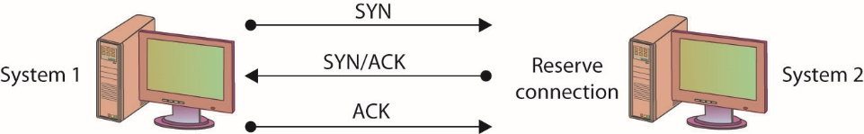
Figure 15.1 The TCP three-way handshake
Notes:
SYN flooding is an example of a DoS attack that takes advantage of the way TCP/IP networks were designed to function, and it can be used to illustrate the basic principles of any DoS attack. SYN flooding uses the TCP three-way handshake that establishes a connection between two systems. Under normal circumstances, the first system sends a SYN packet to the system with which it wants to communicate. The second system responds with a SYN/ACK if it is able to accept the request. When the initial system receives the SYN/ACK from the second system, it responds with an ACK packet, and communication can then proceed. This process is shown in Figure 15.1.

Slide 31
Denial-of-Service Attack (continued)
Steps of a SYN flood attack
Communication request sent to target system.
Target responds to faked IP address.
Target waits for non-existent system response.
Request eventually times out.
If the attacks outpace the requests timing-out, then systems resources will be exhausted.

Slide 32
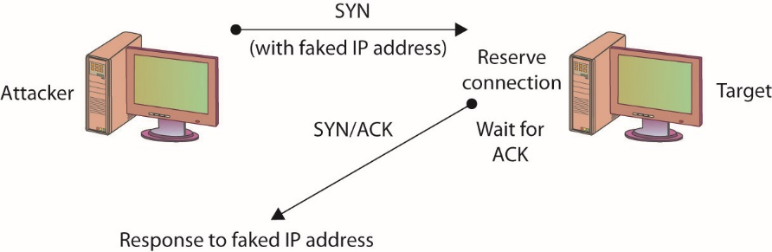
Figure 15.2 A SYN flooding–based DoS attack
Notes:
In a SYN flooding attack, the attacker sends fake communication requests to the targeted system. Each of these requests will be answered by the target system, which then waits for the third part of the handshake. Since the requests are fake (a nonexistent IP address is used in the requests, so the target system is responding to a system that doesn’t exist), the target will wait for responses that never come, as shown in Figure 15.2. The target system will drop these connections after a specific time-out period, but if the attacker sends requests faster than the time-out period eliminates them, the system will quickly be filled with requests. The number of connections a system can support is finite, so when more requests come in than can be processed, the system will soon be reserving all its connections for fake requests. At this point, any further requests are simply dropped (ignored), and legitimate users who want to connect to the target system will not be able to do so, because use of the system has been denied to them.

Slide 33
Denial-of-Service Attack (continued)
Another simple DoS attack is the infamous ping of death (POD).
POD targets a specific application or operating system.
Reminder: SYN flooding targets a protocol.
In the POD attack, the attacker sends an Internet Control Message Protocol (ICMP) ping packet equal to, or exceeding, 64KB.
Certain older systems are not able to handle this size of packet, and the system will hang or crash.

Slide 34
Denial-of-Service Attack (continued)
A DoS attack employing multiple attacking systems is known as a distributed denial-of-service (DDoS) attack.
Denies access or service to authorized users
Uses resources of many systems combined into an attack network
Overwhelms target system or network
With enough attack agents, even simple web traffic can quickly affect a large website
Notes:
Similar to a DoS attack, a Distributed Denial of Service (DDoS) attack has a goal of denying service to authorized users.
The difference between a DoS and DDoS attack centers on the ability of the DDoS to use the combined resources of many systems. An entire network of attack agents can be commandeered and controlled by an attacker.
The combined systems can then overwhelm the target with traffic under the direction of the attacker.
If the attack network is large enough, even simple web traffic can quickly overwhelm even the largest web sites.
A final option you should consider that will address several forms of DoS and DDoS attacks is to block ICMP packets at your border, since many attacks rely on ICMP. Blocking ICMP packets at the border devices prevents external ICMP packets from entering your network, and while this may block some functionality, it will leave internal ICMP functionality intact. It is also possible to block specific forms of ICMP; blocking Type 8, for instance, will block ICMP-based ping sweeps. It is worth noting that not all pings occur via ICMP; some tools, such as hping2, use TCP and UDP to carry ping messages.

Slide 35
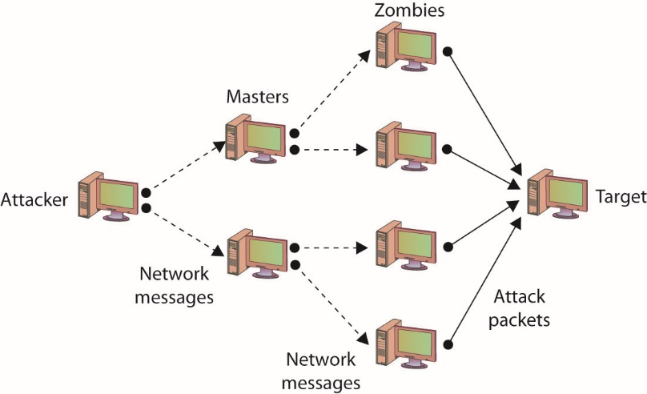
Figure 15.3 DDoS attack
Notes:
Figure 15.3 illustrates a DDoS network with agents and handlers.

Slide 36
Denial-of-Service Attack (continued)
Smurf attack
In a specific DoS attack known as a smurf attack, the attacker sends a spoofed packet to the broadcast address for a network, which distributes the packet to all systems on that network.
Further details are listed in the IP Address Spoofing section.

Slide 37
Denial-of-Service Attack (continued)
Defending against DOS-type attacks
Ensure you have applied the latest patches and upgrades to your systems and the applications running on them.
Change the time-out option for TCP connections so that attacks such as the SYN flooding attack are more difficult to perform.
For DDoS attacks, distribute your workload across several systems.
To prevent a DDoS attack, you must either be able to intercept or block the attack messages or keep the DDoS network from being established in the first place.

Slide 38
Denial-of-Service Attack (continued)
War-dialing is the term used to describe an attacker’s attempt to discover unprotected modem connections to computer systems and networks.
War-dialing was surprisingly successful, mostly because of rogue modems—unauthorized modems attached to computers on a network by authorized users.
War-driving is the unauthorized scanning for and connecting to wireless access points.
Frequently done while driving near a facility
Notes:
War-dialing is an attempt by an attacker to find unprotected modem connections to an organizations computer systems and networks.
Success is often the result of authorized individuals connecting unauthorized or rogue modems to the network. The authorized user’s intent is not usually malicious, but the results can be.
In recent years, advances in telephone firewalls have severely restricted unauthorized connections while also increasing the security of authorized modems as well.
The term war-driving refers to attackers wandering around an area (often in a car), searching for available wireless network connections. There are security measures built into both the hardware and software tasked with maintaining a wireless access point, but it will only operate as well as it is configured.

Slide 39
Social Engineering
Social engineering relies on lies and misrepresentation, which an attacker uses to trick an authorized user into providing information or access the attacker would not normally be entitled to.
Social engineering examples include:
Contacting a system administrator and pretending to be an authorized user, asking to have a password reset
Posing as a representative from a vendor who needs temporary access to perform some emergency maintenance
Notes:
The attacker might, for example, contact a system administrator and pretend to be an authorized user, asking to have a password reset. Another common ploy is to pose as a representative from a vendor who needs temporary access to perform some emergency maintenance. Social engineering also applies to physical access. Simple techniques include impersonating pizza or flower delivery personnel to gain physical access to a facility.
Attackers know that, due to poor security practices, if they can gain physical access to an office, the chances are good that, given a little unsupervised time, a user ID and password pair might be found on a notepad or sticky note.

Slide 40
Null Sessions
Microsoft Windows systems prior to XP and Server 2003 exhibited a vulnerability in their Server Message Block (SMB) system that allowed users to establish null sessions.
A null session is a connection to a Windows inter-process communications share (IPC$).
The good news is that Windows XP, Server 2003, and beyond are not susceptible to this vulnerability by default.

Slide 41
Sniffing
Sniffing is when someone examines all the network traffic that passes their NIC, whether addressed for them or not.
A network sniffer is a software or hardware device.
The device can be used to view all traffic, or it can target a specific protocol, service, or even string of characters.
Sniffers may be able to modify some or all traffic in route
Network administrators can use a sniffer to monitor and troubleshoot network performance.
Notes:
The group of protocols that makes up the TCP/IP suite was designed to work in a friendly environment in which everybody who connected to the network used the protocols as they were designed. The abuse of this friendly assumption is illustrated by network-traffic sniffing programs, sometimes referred to as sniffers.
Sniffing occurs when someone examines all the network traffic that passes their NIC, whether addressed for them or not.
A network sniffer is a software or hardware device that is used to observe traffic as it passes through a network on shared broadcast media.
Sniffing can be used to view all traffic, or it can target a specific protocol, service, or even string of characters (looking for logins, for example).
Some network sniffers are designed not just to observe all traffic but to modify traffic as well.
Network sniffing is more difficult in switched network environments due to the way collision domains are eliminated in full-duplex switching, but certain techniques can be used (spanning ports, ARP poisoning, and attacks forcing a switch to fail and act as a hub) to circumvent this.
Network sniffers can be used by network administrators to monitor network performance.
Network sniffers can be used by attackers to gather information that can be used in penetration attempts.
For network sniffers to be most effective, they need to be on the internal network, which generally means that the chances for outsiders to use them against you are extremely limited.

Slide 42
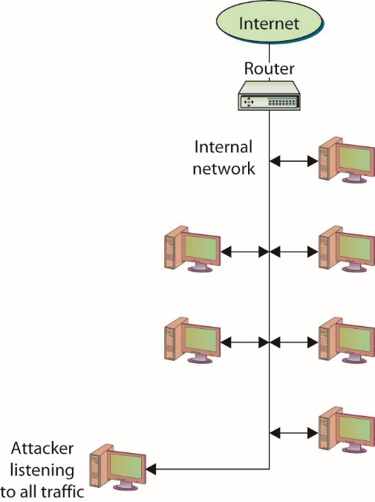
Figure 15.4 Network sniffers listen to all network traffic.
Notes:
Normally, the network device that connects a computer to a network is designed to ignore all traffic that is not destined for that computer.
Network sniffers ignore this friendly agreement and observe all traffic on the network, whether destined for that computer or others, as shown in Figure 15.4.

Slide 43
Spoofing
Spoofing is nothing more than making data look like it has come from a different source.
Spoofing is possible in TCP/IP because of the friendly assumptions behind the protocols.
Protocol assumed that individuals who had access to the network layer would be privileged users who could be trusted.
Notes:
Spoofing is nothing more than making data look like it has come from a different source. This is possible in TCP/IP because of the friendly assumptions behind the protocols. When the protocols were developed, it was assumed that individuals who had access to the network layer would be privileged users who could be trusted.
When a packet is sent from one system to another, it includes not only the destination IP address and port but the source IP address as well. You are supposed to fill in the source with your own address, but nothing stops you from filling in another system’s address. This is one of the several forms of spoofing

Slide 44
Spoofing (continued)
Spoofing e-mail
Occurs when a message is sent with a From address that differs from that of the sending system.
E-mail spoofing examples
Telnet to port 25 on a mail server – From there, you can fill in any address for the From and To sections of the message, whether or not the addresses are yours or even actually exist.
E-mail spoofing variation – Attackers acquire a URL similar to the URL they want to spoof so that e-mail sent from their system appears to have come from the official site.
Notes:
Spoofing E-Mail
In e-mail spoofing, a message is sent with a From address that differs from that of the sending system. This can be easily accomplished in several different ways using several programs.
Recipients can use several methods to determine whether an e-mail message was sent by the source it claims to have been sent from, but most users do not question their e-mail and will accept as authentic where it appears to have originated.

Slide 45
Spoofing (continued)
IP address spoofing
This occurs when a system inserts a different address in the From portion of the IP packet.
In a specific DoS attack known as a smurf attack, the attacker sends a spoofed packet to the broadcast address for a network, which distributes the packet to all systems on that network.

Slide 46
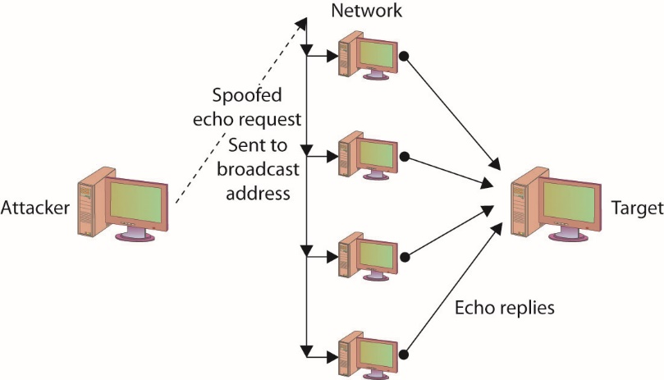
Figure 15.5 Smurfing used in a smurf DOS attack
Notes:
In the smurf attack, the packet sent by the attacker to the broadcast address is an echo request with the From address forged so that it appears that another system (the target system) has made the echo request. The normal response of a system to an echo request is an echo reply, and it is used in the ping utility to let a user know whether a remote system is reachable and is responding. In the smurf attack, the request is sent to all systems on the network, so all will respond with an echo reply to the target system, as shown in Figure 15.5. The attacker has sent one packet and has been able to generate as many as 254 responses aimed at the target. Should the attacker send several of these spoofed requests, or send them to several different networks, the target can quickly become overwhelmed.

Slide 47
Spoofing (continued)
Spoofing and trusted relationships
If two systems are configured to accept the authentication accomplished by each other, an individual logged onto one system might not be forced to go through an authentication process again to access the other system.
An attacker can take advantage of this arrangement by sending a packet to one system that appears to have come from a trusted system.
Since the trusted relationship is in place, the targeted system may perform the requested task without authentication.
Notes:
Spoofing can also take advantage of a trusted relationship between two systems. If two systems are configured to accept the authentication accomplished by each other, an individual logged onto one system might not be forced to go through an authentication process again to access the other system. An attacker can take advantage of this arrangement by sending a packet to one system that appears to have come from a trusted system. Since the trusted relationship is in place, the targeted system may perform the requested task without authentication.

Slide 48
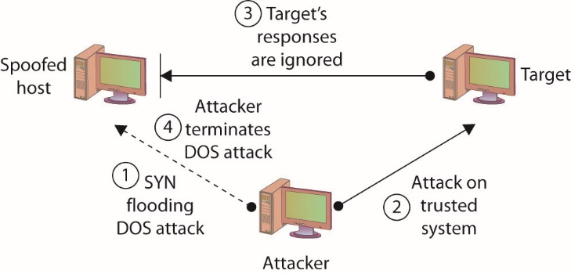
Figure 15.6 Spoofing to take advantage of a trusted relationship
Notes:
Figure 15.6 illustrates a spoofing attack that includes a SYN flooding attack.

Slide 49
Spoofing (continued)
Spoofing and sequence numbers
Formulating packets is more complicated for external attackers because of sequence number.
A sequence number is a 32-bit number established by the host that is incremented for each packet sent.
Packets are not guaranteed to be received in order; the sequence number can be used to help reorder packets.
The difference in the difficulty of attempting a spoofing attack from inside a network and from outside involves determining the sequence number.
Notes:
How complicated the spoofing is depends heavily on several factors, including whether the traffic is encrypted and where the attacker is located relative to the target. Spoofing attacks from inside a network, for example, are much easier to perform than attacks from outside of the network, because the inside attacker can observe the traffic to and from the target and can do a better job of formulating the necessary packets.
Formulating the packets is more complicated for external attackers because a sequence number is associated with TCP packets. A sequence number is a 32-bit number established by the host that is incremented for each packet sent. Packets are not guaranteed to be received in order, and the sequence number can be used to help reorder packets as they are received and to refer to packets that may have been lost in transmission.
The difference in the difficulty of attempting a spoofing attack from inside a network and from outside involves determining the sequence number.
If the attacker is inside of the network and can observe the traffic with which the target host responds, the attacker can easily see the sequence number the system creates and can respond with the correct sequence number.
If the attacker is external to the network and the sequence number the target system generates is not observed, it is next to impossible for the attacker to provide the final ACK with the correct sequence number. So the attacker has to guess what the sequence number might be.

Slide 50
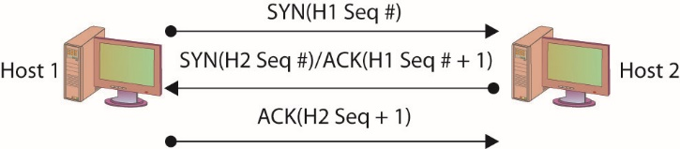
Figure 15.7 Three-way handshake with sequence numbers
Notes:
In the TCP three-way handshake, two sets of sequence numbers are created, as shown in Figure 15.7.
The first system chooses a sequence number to send with the original SYN packet. The system receiving this SYN packet acknowledges with a SYN/ACK. It sends an acknowledgment number back, which is based on the first sequence number plus one (that is, it increments the sequence number sent to it by one). It then also creates its own sequence number and sends that along with it. The original system receives the SYN/ACK with the new sequence number. It increments the sequence number by one and uses it as the acknowledgment number in the ACK packet with which it responds.

Slide 51
TCP/IP Hijacking
TCP/IP hijacking and session hijacking are terms used to refer to the process of taking control of an already existing session between a client and a server.
Attacker does not have to circumvent any authentication mechanisms.
Attack can be disguised with a DoS attack.
Hijack attacks generally are used against web and Telnet sessions.
Notes:
TCP/IP hijacking and session hijacking are terms used to refer to the process of taking control of an already existing session between a client and a server.
The advantage to an attacker of hijacking over attempting to penetrate a computer system or network is that the attacker doesn’t have to circumvent any authentication mechanisms, since the user has already authenticated and established the session.
To prevent the user from noticing anything unusual, the attacker can decide to attack the user’s system and perform a DoS attack on it, taking it down so that the user, and the system, will not notice the extra traffic that is taking place.
Hijack attacks generally are used against web and Telnet sessions. Sequence numbers as they apply to spoofing also apply to session hijacking, since the hijacker will need to provide the correct sequence number to continue the appropriated sessions.

Slide 52
Man-in-the-Middle Attacks
A man-in-the-middle attack generally occurs when attackers are able to place themselves in the middle of two other hosts that are communicating.
Attack is typically accomplished by compromising a router to alter the path of the traffic.
A common method of instantiating a man-in-the-middle attack is via session hijacking.
Session hijacking can occur when information such as a cookie is stolen, allowing the attacker to impersonate the legitimate session.
Can result from a cross-site scripting attack
Notes:
A man-in-the-middle attack generally occurs when attackers are able to place themselves in the middle of two other hosts that are communicating.
A man-in-the-middle attack can be accomplished by compromising a router to alter the path of the traffic.
The attacker can then observe all traffic before relaying it and can actually modify or block traffic.
To the target host, it appears that communication is occurring normally, since all expected replies are received.
There are numerous methods of instantiating a man-in-the-middle attack; one of the common methods is via session hijacking. Session hijacking can occur when information such as a cookie is stolen, allowing the attacker to impersonate the legitimate session. This attack can be as a result of a cross-site scripting attack, which tricks a user into executing code resulting in cookie theft. The amount of information that can be obtained in a man-in-the-middle attack will obviously be limited if the communication is encrypted. Even in this case, however, sensitive information can still be obtained, since knowing what communication is being conducted, and between which individuals, may, in fact, provide information that is valuable in certain circumstances.

Slide 53
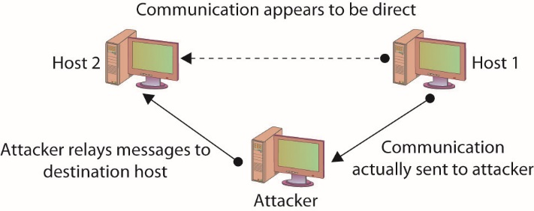
Figure 15.8 A man-in-the-middle attack
Notes:
A man-in-the-middle attack is ideally, accomplished by ensuring that all communication going to or from the target host is routed through the attacker’s host (which can be accomplished if the attacker can compromise the router for the target host). The attacker can then observe all traffic before relaying it and can actually modify or block traffic. To the target host, it appears that communication is occurring normally, since all expected replies are received. Figure 15.8 illustrates this type of attack.

Slide 54
Man-in-the-Middle Attacks (continued)
The term “man-in-the-middle attack” is sometimes used to refer to a more specific type of attack—one in which the encrypted traffic issue is addressed.
An attacker can conduct a man-in-the-middle attack by intercepting a request for a friend’s public key and the sending of your public key to him.
Well-designed cryptographic products use techniques such as mutual authentication to avoid this problem.

Slide 55
Replay Attack
A replay attack occurs when the attacker captures a portion of a communication between two parties and retransmits it at a later time.
Replay attacks are associated with attempts to circumvent authentication mechanisms.
The best way to prevent replay attacks is with encryption, cryptographic authentication, and time stamps.
Notes:
A replay attack occurs when the attacker captures a portion of a communication between two parties and retransmits it at a later time.
Generally replay attacks are associated with attempts to circumvent authentication mechanisms, such as the capturing and reuse of a certificate or ticket.
The best way to prevent replay attacks is with encryption, cryptographic authentication, and time stamps. If a portion of the certificate or ticket includes a date/time stamp or an expiration date/time, and this portion is also encrypted as part of the ticket or certificate, replaying it at a later time will prove useless, since it will be rejected as having expired.

Slide 56
Transitive Access
Transitive access is a means of attacking a system by violating the trust relationship between machines.
A simple example is when servers are well protected and clients are not, and the servers trust the clients.
In this case, attacking a client can provide transitive access to the servers.

Slide 57
Spam
Though not generally considered a social engineering issue, nor a security issue for that matter, spam can, however, be a security concern.
Spam is bulk unsolicited e-mail.
It can be legitimate in the sense that it has been sent by a company advertising a product or service.
Spam can also be malicious and could include an attachment that contains malicious software designed to harm your system, or a link to a malicious web site that may attempt to obtain personal information from you.
Notes:
Though not generally considered a social engineering issue, nor a security issue for that matter, spam can, however, be a security concern. Spam, as just about everybody knows, is bulk unsolicited e-mail. It can be legitimate in the sense that it has been sent by a company advertising a product or service, but it can also be malicious and could include an attachment that contains malicious software designed to harm your system, or a link to a malicious web site that may attempt to obtain personal information from you.

Slide 58
Spim
Though not as well known, a variation on spam is spim, which is basically spam delivered via an instant messaging application such as Yahoo! Messenger or AOL Instant Messenger (AIM).
The purpose of hostile spim is the same as that of spam—the delivery of malicious content or links.

Slide 59
Phishing
Phishing is the use of fraudulent e-mails or instant messages that appear to be genuine but are designed to trick users.
The goal of a phishing attack is to obtain from the user information that can be used in an attack, such as login credentials or other critical information.

Slide 60
Spear Phishing
Spear phishing is the term that has been created to refer to a phishing attack that targets a specific group with something in common.
By targeting a specific group, the ratio of successful attacks (that is, the number of responses received) to the total number of e-mails or messages sent usually increases because a targeted attack will seem more plausible than a message sent to users randomly.

Slide 61
Vishing
Vishing is a variation of phishing that uses voice communication technology to obtain the information the attacker is seeking.
Vishing takes advantage of the trust that some people place in the telephone network.
Users are unaware that attackers can spoof (simulate) calls from legitimate entities using voice over IP (VoIP) technology.
Voice messaging can also be compromised and used in these attempts.
Attackers seek to obtain information for identity theft.
Notes:
Generally, the attackers are hoping to obtain credit card numbers or other information that can be used in identity theft. The user may receive an e-mail asking him or her to call a number that is answered by a potentially compromised voice message system. Users may also receive a recorded message that appears to come from a legitimate entity. In both cases, the user will be encouraged to respond quickly and provide the sensitive information so that access to their account is not blocked. If a user ever receives a message that claims to be from a reputable entity and asks for sensitive information, the user should not provide it but instead should use the Internet or examine a legitimate account statement to find a phone number that can be used to contact the entity. The user can then verify that the message received was legitimate or report the vishing attempt.

Slide 62
Pharming
Pharming consists of misdirecting users to fake web sites that have been made to look official.
Users directed to the fake web site as a result of activity such as DNS poisoning or modification of local host.
Once at the fake web site, the user may supply personal information, believing that they are connected to the legitimate site.

Slide 63
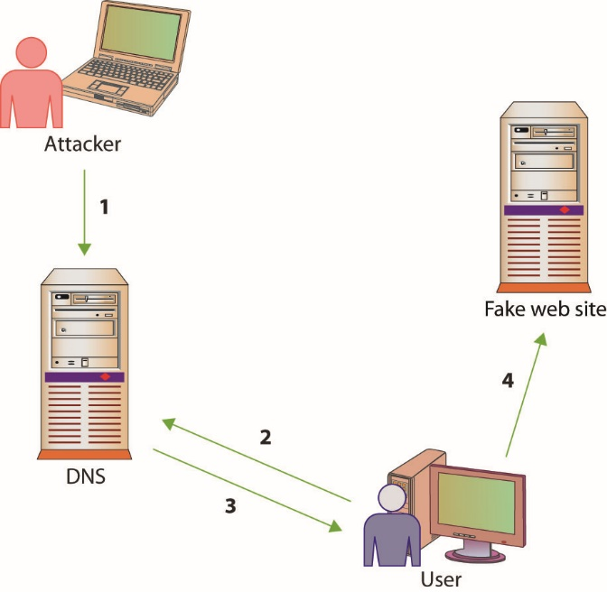
Figure 15.9 How pharming works
Notes:
Figure 15.9 illustrates how pharming operates. The first step is an attacker poisons the DNS system, so when the user queries it (step 2) they get a false address (step 3). This results in the user being directed to the fake web site (step 4).

Slide 64
Scanning Attacks
Scanners can be used to send specifically crafted packets in an attempt to determine TCP/UDP port status.
An XMAS scan uses the URG, PSH, and FIN flags to determine TCP port availability.
If the port is closed, an RST is returned.
If the port is open, there is typically no return.
Advanced firewalls can detect these packets, alerting people to the scanning activities.
Notes:
An XMAS scan can help determine OS type and version, based upon TCP/IP stack responses, and can also help determine firewall rules. These attacks can also be used to consume system resources, resulting in DoS.
Simple stateless firewalls check for the SYN flag set to prevent SYN floods, and Christmas packets are designed not to have SYN set, so they pass right by these devices.

Slide 65
Attacks on Encryption
Encryption is the process of transforming plaintext into an unreadable format known as ciphertext using a specific technique or algorithm.
Most encryption techniques use some form of key in the encryption process.
Cryptanalysis is the process of attempting to break a cryptographic system—it is an attack on the specific method used to encrypt the plaintext.
Cryptographic systems can be compromised in various ways.

Slide 66
Attacks on Encryption (continued)
Certain encryption algorithms may have specific keys that yield poor, or easily decrypted, ciphertext.
An exhaustive search of the keyspace will decrypt the message.
The strength of the encryption method is related to the sheer size of the keyspace.
You cannot immediately compare different key lengths from different algorithms and assume relative strength.

Slide 67
Attacks on Encryption (continued)
One of the most common ways of attacking an encryption system is to find weaknesses in mechanisms surrounding the cryptography.
It is not the cryptographic algorithm itself that is being attacked, but rather the implementation of that algorithm in the real world.

Slide 68
Address System Attacks
IP addresses and other addresses can be manipulated.
DNS kiting, is an economic attack against the terms of using a new DNS entry.
Another twist on this scheme is the concept of domain name front running, where a registrar places a name on a five-day hold after someone searches for it, and then offers it for sale at a higher price.
Notes:
Exam Tip: The process of using a new domain name for the five-day “test” period and then relinquishing the name, only to repeat the process again—in essence, obtaining a domain name for free—is called DNS kiting.

Slide 69
Cache Poisoning
Caches can also be poisoned, sending incorrect information to the end user’s application, redirecting traffic, and changing system behaviors.

Slide 70
Cache Poisoning (continued)
A DNS poisoning attack occurs when network connections are changed, resulting in different DNS lookups.
DNS poisoning can occur at any level.
At times, nslookup will return a nonauthoritative answer.
DNS poisoning is a variant of a larger attack class referred to as DNS spoofing, in which an attacker changes a DNS record through any of a multitude of means.

Slide 71
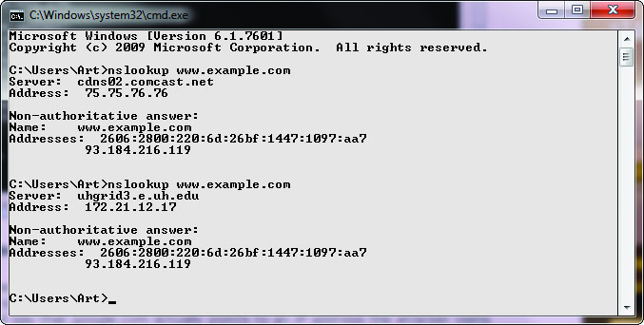
Figure 15.10 nslookup of a DNS query
Notes:
Figure 15.10 shows a series of DNS queries executed on a Windows machine. In the first request, the DNS server was with an ISP, while on the second request, the DNS server was from a VPN connection. Between the two requests, the network connections were changed, resulting in different DNS lookups. This is a form of DNS poisoning attack.

Slide 72
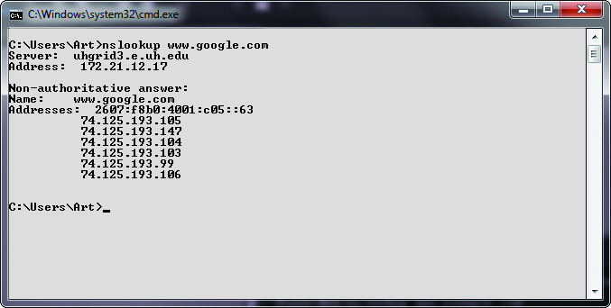
Figure 15.11 Cache response to a DNS query
Notes:
At times, nslookup will return a nonauthoritative answer, as shown in Figure 15.11. This typically means the result is from a cache as opposed to a server that has an authoritative (that is, known to be current) answer.

Slide 73
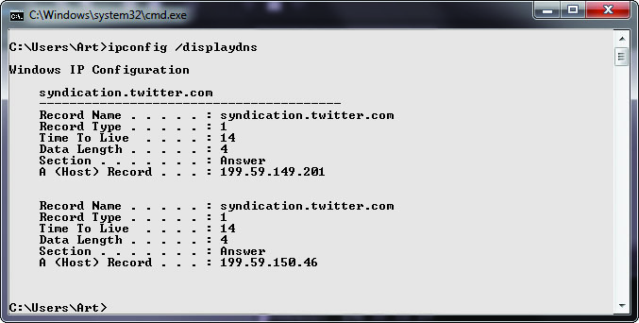
Figure 15.12 Cache response to a DNS table query
Notes:
There are other commands you can use to examine and manipulate the DNS cache on a system. In Windows, the ipconfig/displaydns command will show the current DNS cache on a machine.
Figure 15.12 shows a small DNS cache. This cache was recently emptied using the ipconfig /flushdns command to make it fit on the screen.

Slide 74
Cache Poisoning (continued)
ARP poisoning involves an attacker sending messages, corrupting the ARP table, and causing packets to be misrouted.
This form of attack results in malicious address redirection.
This can allow a mechanism whereby an attacker can inject themselves into the middle of a conversation between two machines, a man-in-the-middle attack.
Local MAC addresses can also be poisoned in the same manner, although it is called ARP poisoning.

Slide 75
Password Guessing
The most common form of authentication is the user ID and password combination
While it is not inherently a poor mechanism for authentication, the combination can be attacked in several ways.
All too often, these attacks yield favorable results for the attacker not as a result of a weakness in the scheme but usually due to the user not following good password procedures.

Slide 76
Password Guessing (continued)
People are notorious for picking poor passwords.
Users need to select a password that they can remember, so they create simple passwords.
The attacker just needs to obtain a valid user ID and some information about the user before guessing can begin.
A password-cracking program can uses a list of dictionary words to try to guess the password.
Rules can also be defined so that the cracking program will substitute special characters for other characters or combine words.

Slide 77
Password Guessing (continued)
In a brute-force attack, a password-cracking program attempts all possible character combinations.
There are two levels of brute-force attack:
Use a password-cracking program to attempt to guess the password directly at a login prompt
Steal a password file and use a password-cracking program to compile a list of possible passwords based on the list of password hashes contained in the password file (offline)
Use narrower list to attempt to guess the password at the login prompt
Notes:
A brute-force attack on a password can take place at two levels:
The attacker can use a password-cracking program to attempt to guess the password directly at a login prompt. The attack can be made more difficult if the account locks after a few failed login attempts.
The attacker can first steal a password file, use a password-cracking program to compile a list of possible passwords based on the list of password hashes contained in the password file (offline), and then use that narrower list to attempt to guess the password at the login prompt. The second attack can be thwarted if the password file is securely maintained so that others cannot obtain a copy of it.

Slide 78
Password Guessing (continued)
A hybrid password attack is an attack that combines the preceding dictionary and brute-force methods.
The birthday attack is a special type of brute-force attack
Uses the birthday paradox that states that in a group of at least 23 people, the chance that two individuals will have the same birthday is greater than 50 percent.
Mathematically, the equation is 1.25×k^{1/2}, where k equals the size of the set of possible values, which in the birthday paradox is 365
Notes:
The birthday attack phenomenon applies to passwords, with k (number of passwords) being quite a bit larger.

Slide 79
Pass-the-Hash Attacks
Pass the hash is a hacking technique where the attacker captures the hash used to authenticate a process.
The attacker can then use this hash by injecting it into a process in place of the password.
This is a highly technical attack, targeting the Windows authentication process, injecting a copy of the password hash directly into the system.
The attacker does not need to know the password.
Notes:
The attacker does not need to know the password, but instead can use a captured hash and inject it directly, which will verify correctly, granting access. As this is a very technically specific hack, tools have been developed to facilitate its operation.

Slide 80
Software Exploitation
Software exploitation is an attack that takes advantage of bugs or weaknesses in software.
Can be the result of poor design, poor testing, or poor coding practices
Can result from what are sometimes called “features”
A preventable problem
Fuzzing: the automated process of applying large sets of inputs to a system and analyzing the output to determine exploitable weaknesses
Can exploit error messages from applications

Slide 81
Software Exploitation (continued)
A common weakness that has often been exploited is a buffer overflow, which occurs when a program is provided more data for input than it was designed to handle.
An integer overflow is a programming error condition that occurs when a program attempts to store a numeric value, an integer, in a variable that is too small to hold it.

Slide 82
Client-Side Attacks
The web browser has become the major application for users to engage resources across the Web.
The popularity and the utility of this interface has made it a prime target for attackers to gain access and control over a system.
A wide variety of attacks can occur via a browser, typically resulting from a failure to validate input properly before use.
Unvalidated input can result in a series of injection attacks, header manipulation, and others.

Slide 83
Client-Side Attacks (continued)
SQL injection attacks and command injection attacks can provide attackers with unauthorized access.
When HTTP is being dynamically generated through the use of user inputs, unvalidated inputs can give attackers an opportunity to change HTTP elements.
When user-supplied information is used in a header, it is possible to deploy a variety of attacks, including cache poisoning, cross-site scripting, cross-user defacement, page hijacking, cookie manipulation, and open redirect.

Slide 84
Client-Side Attacks (continued)
Typo squatting is an attack form that involves capitalizing upon common typo errors.
This attack pattern is also referred to as URL hijacking, fake URL, or brandjacking if the objective is to deceive based on branding.
A drive-by download attack automatically downloads malware within browser, whether a user clicks or not.

Slide 85
Client-Side Attacks (continued)
Attackers can plant malware at sites where users are likely to frequent.
Watering hole attacks involve the infecting of a target web site with malware.
These are not simple attacks, yet they can be very effective at delivering malware to specific groups of end users.
Watering hole attacks are complex to achieve and appear to be backed by nation-states and other high-resource attackers.

Slide 86
Advanced Persistent Threat
The advanced persistent threat (APT) is a method of attack that primarily focuses on stealth and continuous presence on a system.
APT is a very advanced method, requiring a team to maintain access and typically involves high-value targets.
APT typically involves specially crafted attack vectors, coupled with phishing or spear phishing for the initial entry.
Then techniques are employed to develop backdoors and multiple account access routes.

Slide 87
Remote Access Trojans
Remote access Trojans (RATs) are malware designed to enable remote access to a machine.
Similar to remote desktop administration, but rather than being visible to a user, it is hidden in the system.
RATs enable attackers to have a way back into a system.
The principal use of a RAT is to enable re-entry to a system and/or collect data on a system.
A key function of a RAT is to provide a periodic beacon out, so even if firewalls and other security devices block unrequested packets, the beacon function makes them requested, bypassing many security checks.

Slide 88
Tools
There are a variety of toolsets used by security professionals that could also be used for malicious purposes.
These toolsets are used by penetration testers when testing the security posture of a system.
The same tools in the hands of an adversary can be used for malicious purposes.

Slide 89
Metasploit
Metasploit is a framework that enables attackers to exploit systems (bypass controls) and inject payloads (attack code) into a system.
Metasploit is widely distributed, powerful, and one of the most popular tools used by attackers.
When new vulnerabilities are discovered in systems, Metasploit exploit modules are quickly created in the community, making this tool the go-to tool for most professionals.

Slide 90
BackTrack/Kali
BackTrack is a Linux distribution that is preloaded with many security tools.
The current version is called Kali Linux.
It includes a whole host of preconfigured, preloaded tools, including Metasploit, Social-Engineering Toolkit, and others.

Slide 91
Social-Engineering Toolkit
The Social-Engineering Toolkit (SET) is a set of tools that can be used to target attacks toward the people using systems.
It has applets that can be used to create phishing e-mails, Java attack code, and other social engineering–type attacks.
The SET is included in BackTrack/Kali and other distributions.

Slide 92
Cobalt Strike
Cobalt Strike is a powerful application that can replicate advanced threats and assist in the execution of targeted attacks on systems.
Cobalt Strike expands the Armitage tool’s capabilities, adding advanced attack methods.

Slide 93
Core Impact
Core Impact is an expensive commercial suite of penetration test tools.
It has a wide spectrum of tools and proven attack abilities across an enterprise.
Although expensive, the level of automation and integration makes this a powerful suite of tools.

Slide 94
Burp Suite
Burp Suite began as a port scanner tool with limited additional functionality in the arena of intercepting proxies, web application scanning, and web-based content.
Burp Suite is a commercial tool, but it is reasonably priced and well liked and utilized in the pen-testing marketplace.

Slide 95
Auditing
Auditing in the computer security world is a process of assessing the security state of an organization compared against an established standard.
Auditing should be conducted on a regular basis.
Audits differ from security or vulnerability assessments.
Auditing can be contracted out to a another party.
An assessment should include:
Security perimeter
Policies, procedures, and guidelines governing security
Employee training
Notes:
The important elements here are the standards. Organizations from different communities may have widely different standards, and any audit will need to consider the appropriate elements for the specific community. Audits differ from security or vulnerability assessments in that assessments measure the security posture of the organization but may do so without any mandated standards against which to compare them. In a security assessment, general security “best practices” can be used, but they may lack the regulatory teeth that standards often provide. Penetration tests can also be encountered—these tests are conducted against an organization to determine whether any holes in the organization’s security can be found. The goal of the penetration test is to penetrate the security rather than measure it against some standard. Penetration tests are often viewed as white-hat hacking in that the methods used often mirror those that attackers (often called black hats) might use.

Slide 96
Perform Routine Audits
Examples of items that should be audited on a regular basis include:
User access
User rights
Storage
Retention
Firewall rules
Notes:
As part of any good security program, administrators must perform periodic audits to ensure things “are as they should be” with regard to users, systems, policies, and procedures. Installing and configuring security mechanisms is important, but they must be reviewed on a regularly scheduled basis to ensure they are effective, up to date, and serving their intended function. Here are some examples, but by no means a complete list, of items that should be audited on a regular basis:
User access – Administrators should review which users are accessing the systems, when they are doing so, what resources they are using, and so on. Administrators should look closely for users accessing resources improperly or accessing legitimate resources at unusual times.
User rights – When a user changes jobs or responsibilities, she will likely need to be assigned different access permissions; she may gain access to new resources and lose access to others. To ensure that users have access only to the resources and capabilities they need for their current positions, all user rights should be audited periodically.
Storage – Many organizations have policies governing what can be stored on “company” resources and how much space can be used by a given user or group. Periodic audits help to ensure that no undesirable or illegal materials exist on organizational resources.
Retention – In some organizations, how long a particular document or record is stored can be as important as what is being stored. A records retention policy helps to define what is stored, how it is stored, how long it is stored, and how it is disposed of when the time comes. Periodic audits help to ensure that records or documents are removed when they are no longer needed.
Firewall rules – Periodic audits of firewall rules are important to ensure the firewall is filtering traffic as desired and to help ensure that “temporary” rules do not end up as permanent additions to the rule set.

Slide 97
Chapter Summary
Describe the various types of computer and network attacks, including denial-of-service, spoofing, hijacking, and password guessing.
Identify the different types of malicious software that exist, including viruses, worms, Trojan horses, logic bombs, time bombs, and rootkits.
Explain how social engineering can be used as a means to gain access to computers and networks.
Describe the importance of auditing and what should be audited.

